Slide 1
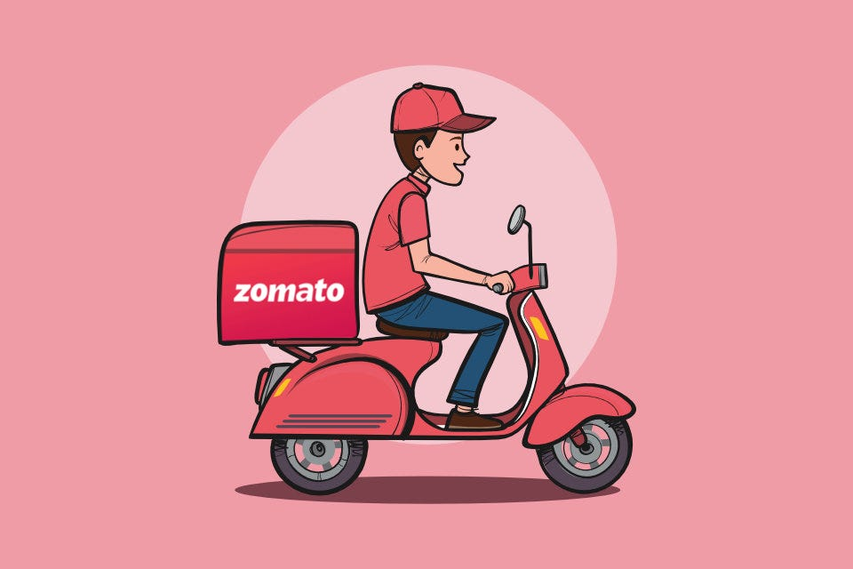
Zomato Restaurants Analysis
Mudassir Attar

Slide 2
Introduction and Objectives
The restaurant industry is constantly evolving, with businesses seeking data-driven insights to expand strategically and maximize profitability.
This project focuses on developing an interactive dashboard to analyze restaurant data, providing key insights for informed decision-making regarding expansion opportunities.
Project Context & Objectives
The primary goal is to analyze restaurant data across various country, identifying potential markets for expansion while considering factors such as competition, customer preferences, and pricing strategies. This will be achieved through:
Data Assessment
Market Insights
Consumer Preferences
Competitor Analysis
Financial Considerations
Identifying countries, cities, and states with lower competition and higher potential for new restaurants.
Evaluating the impact of pricing, online delivery, table booking, and cuisine choices on restaurant ratings.
Identifying key competitors and assessing their ratings, pricing strategies, and customer feedback.
Understanding the dataset by analyzing tables, attributes, and data consistency.
Analyzing expenditure trends in different countries to maintain cost-effective expansion.

Slide 3

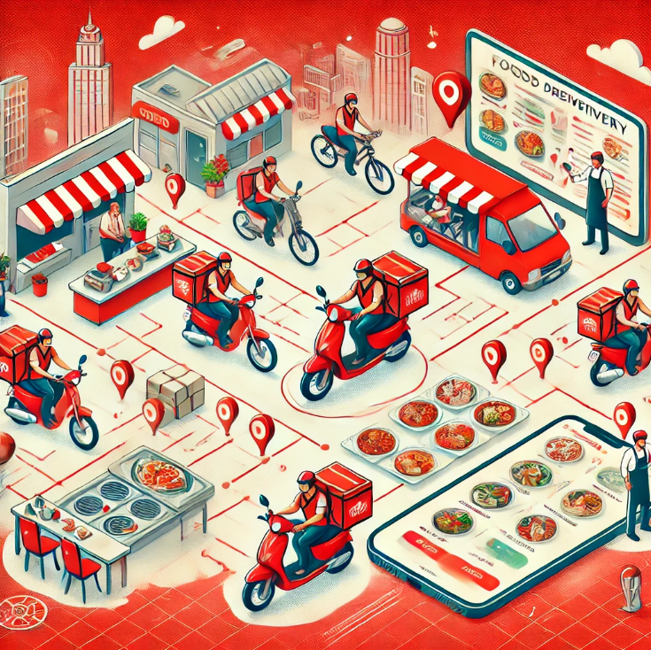
About Zomato
Zomato collaborates with 500,000+ restaurants globally, providing users access to a diverse range of cuisines, menus, reviews, and ratings.
It connects food lovers with top eateries, from local favorites to international chains.
Zomato helps restaurants optimize their services with insights on peak hours, pricing strategies, and customer preferences.
The platform also supports cloud kitchens and exclusive restaurant partnerships for enhanced food delivery efficiency.

Slide 4

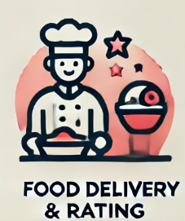



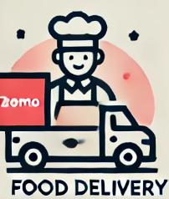
How Zomato works
Step 1:
Restaurants and food outlets list their menus on the Zomato platform, making them accessible to customers.
Step 5:
Customers receive their food, rate their experience, and leave reviews, helping others make informed choices.
Step 2:
Customers browse restaurants, view menus, read reviews, and place food orders through the Zomato app.
Step 4:
A Zomato delivery partner picks up the order from the restaurant and delivers it to the customer’s location.
Step 3:
The restaurant receives the order, prepares the food, and updates the status for tracking.

Slide 5

Zomato Restaurants Data snapshots
Total Tables in the Data
The dataset consists of 2 tables:
Raw Data – Contains restaurant details (location, price_range, cuisine, ratings).
Country Description – Maps country codes to country names.
Total Attributes
Raw Data Table: 20 attributes (restaurant-related details).
Country Description Table: 2 attributes (country name & code).
Categorical Columns
The dataset contains 13 categorical columns, including:
Data Cleaning & Processing
Removed unnecessary columns: Address, LocalityVerbose, Longitude, Latitude.
Handled missing values: Filled blank Cuisines with "Other Cuisines".
Corrected date format: Ensured proper date format is representation.
Filling Country Names in Raw Data: Country names are mapped using country codes by referencing the Country Description table using VLOOKUP, ensuring accurate and consistent data mapping.
Column V & U in the 'Raw Data' sheet automatically converts various currencies into Indian Rupees (INR) & Dollar ($) using a reference table from the 'HELP' sheet, ensuring accurate and consistent currency conversion.

Slide 6
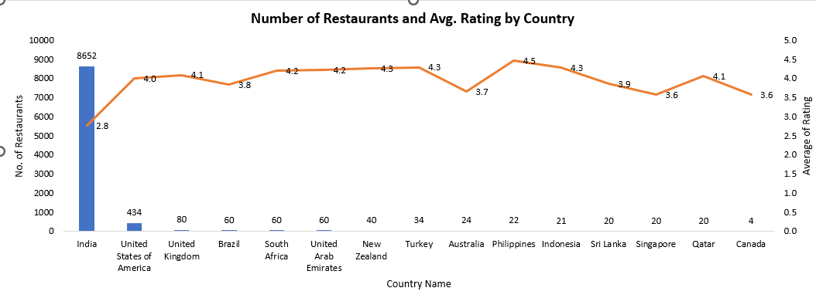
Country-Wise Restaurant Distribution & Ratings
Total Restaurants: The dataset includes 9,551 restaurants across multiple countries, with India contributing the highest share (90%+)
India leads in restaurant count (8652), but has the lowest average rating (2.8) – indicating potential quality concerns or stricter rating culture.
The Philippines has the highest average rating (4.5), followed by New Zealand, Turkey, and Indonesia (4.3) – suggesting strong customer satisfaction.
The USA (434 restaurants) and UK (80) have moderate presence with good ratings (4.0–4.1), making them stable markets.
Countries like UAE, South Africa, and Qatar (4.1–4.2) have fewer restaurants but high ratings, indicating premium or good dining experiences.
Growth Opportunity: India has volume but lower ratings – improving service & quality could drive better customer satisfaction and business success.

Slide 7
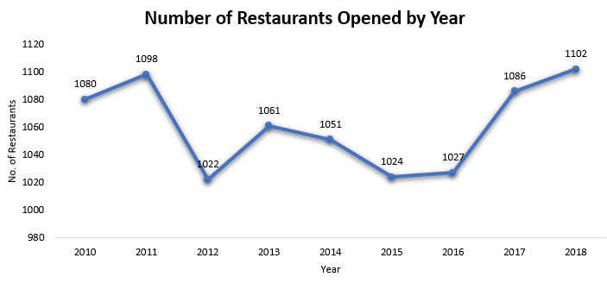
Yearly Trend of Restaurant Openings
The highest number of restaurants opened was in 2018, with 1102. The lowest was in 2012, with 1022 restaurants.
Overall, the number of restaurants opened remained relatively consistent throughout the years, fluctuating around 1000 per year.
Consider examining the years with the highest openings (e.g., 2011, 2017, 2018) to understand the factors contributing to these peaks, and use those insights to replicate success in upcoming years.

Slide 8
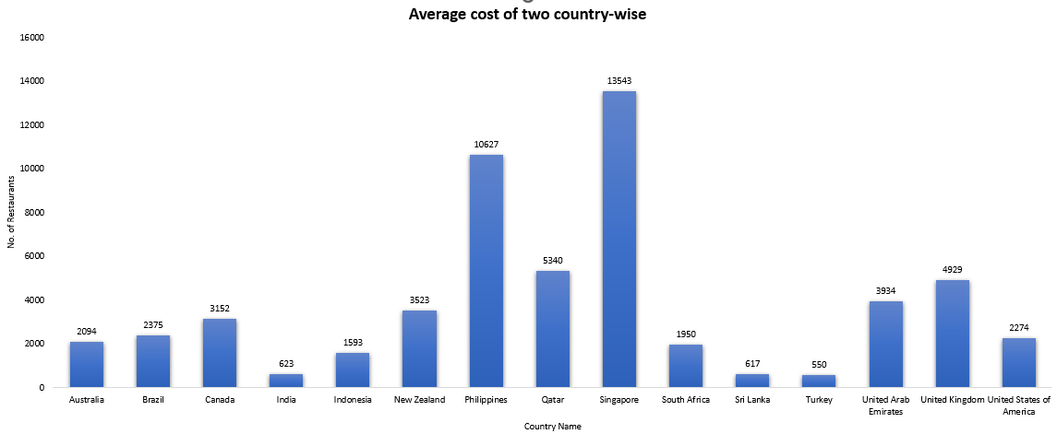
Average Cost for Two across countries
India, Sri Lanka, and Turkey have the lowest dining costs (₹550–₹623), making them budget-friendly markets.
Singapore (₹13,543) and the Philippines (₹10,627) have the highest average costs, indicating premium dining experiences.
Western countries like the UK (₹4,929), UAE (₹3,934), and Canada (₹3,152) have mid-to-high dining costs, suggesting a balance between affordability and premium options.
Global Average is ₹853, much lower than high-cost regions, showing significant cost variations across countries.

Slide 9
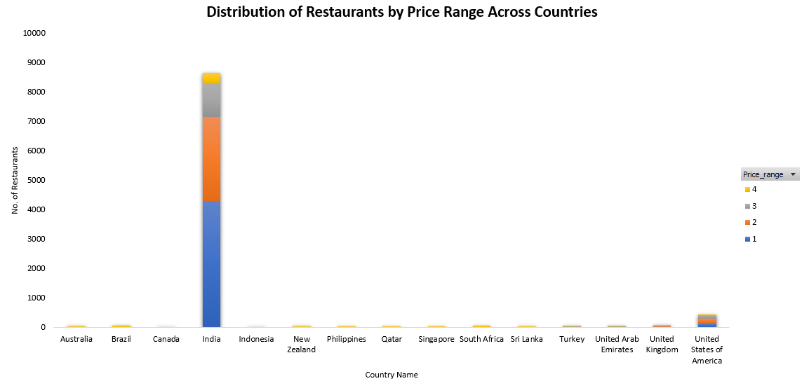
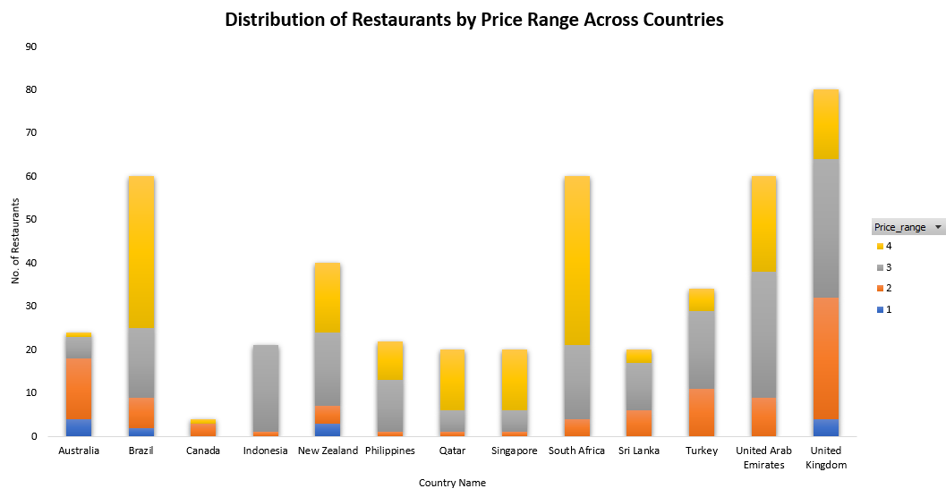
Distribution of Restaurants by Price Range
India dominates the restaurant count, with the majority falling under lower price ranges (1 & 2), showing a preference for affordable dining.
Developed nations like the U.S., U.K., and Australia have a more even distribution across all price ranges, indicating diverse customer preferences.
Countries like Brazil and South Africa have a higher number of premium restaurants (price range 4), suggesting a market for fine dining.
Recommendation:
Focus on expanding budget-friendly restaurants in India and other high-volume markets to cater to the larger customer base.
For developed countries, like the U.S., U.K., and Australia offer a mix of casual and fine dining to match the broad consumer demand across all price ranges.
Capitalize on premium dining in Brazil, South Africa, and Qatar, where high-end restaurants have a stronger presence.

Slide 10
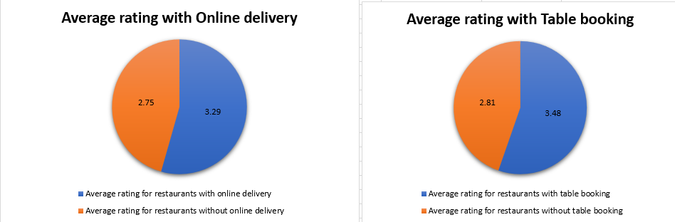
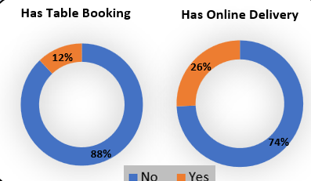

Online Delivery & Table Booking
Restaurants with online delivery have a higher average rating (3.29) than those without (2.75), and those with table booking also perform better (3.48 vs. 2.81). This suggests that both services positively impact customer ratings.
Implementing online delivery and table booking is advisable to enhance customer satisfaction and ratings. Prioritize seamless user experience and service quality to maximize benefits.
Around 12% restaurants has table booking and rest don’t have the table booking
Around 26% restaurants has online delivery and 74% don’t serve online

Slide 11
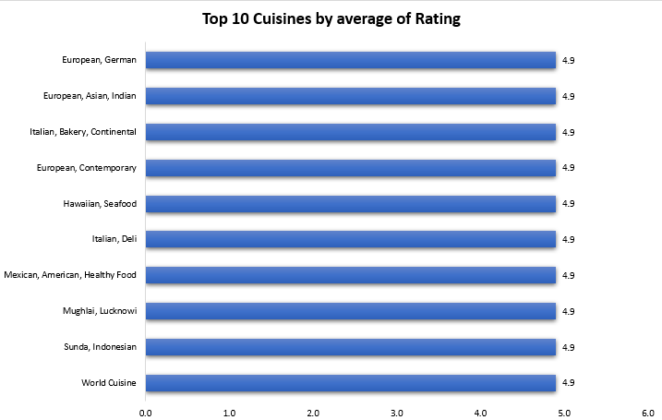
Top Cuisines based on Avg. Rating
All listed cuisines maintain a consistently high average rating of 4.9, reflecting excellent customer satisfaction and positive dining experiences.
The variety of cuisines, including fusion, traditional, and regional specialties, indicates a broad and diverse appeal among customers.
European cuisine appears frequently, suggesting a strong preference for its different styles, from contemporary to bakery and German influences.

Slide 12
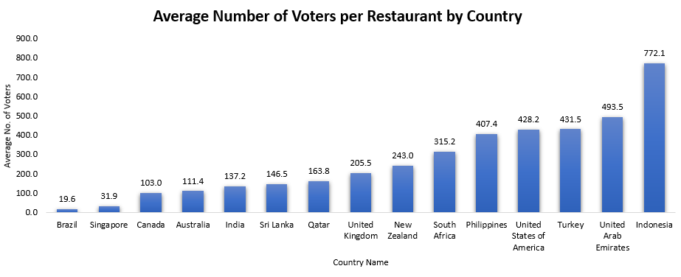
Voters per Country
Indonesia and United Arab Emirates have the highest average number of votes per restaurant (772.10 and 493.52, respectively), indicating higher engagement or a more active voting population.
Countries like Brazil, Singapore, show relatively lower averages (around 19 to 31 votes), which may suggest less customer engagement or fewer restaurants per country.
South Africa, Philippines and United States of America have moderate averages (315 to 428), indicating a balanced level of voter participation.
Focus on increasing customer engagement in countries with lower averages, such as Brazil and Singapore, by implementing targeted marketing strategies or loyalty programs.
Investigate factors driving high voter engagement in countries like Indonesia and Turkey, and consider replicating successful practices in other countries.

Slide 13
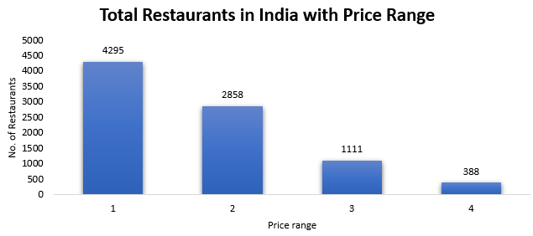
Indian Market
Out of 9,551, India has the highest number with 8,652 restaurants
Price Range 1 (4295 restaurants) – The majority of restaurants fall into the most affordable category, indicating a high demand for budget-friendly dining options.
Price Range 2 (2858 restaurants) – A significant number of restaurants are in the mid-range pricing, catering to customers looking for a balance between affordability and quality.
Price Range 3 (1111 restaurants) – Fewer restaurants exist in this premium category, suggesting that higher-priced establishments are less common.
Price Range 4 (388 restaurants) – The least number of restaurants fall into this highest price range, indicating that luxury dining options are relatively rare.

Slide 14
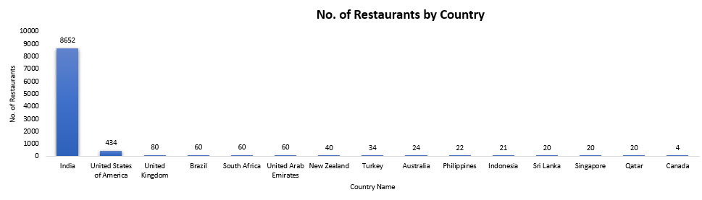
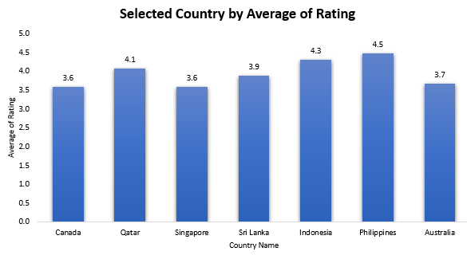
Business Expansion Opportunities
Low Competition, High Potential: Countries like Canada (4), Qatar (20), and Sri Lanka (20) have fewer restaurants, presenting strong opportunities for expansion.
Highly Saturated Markets:
India (8652) and the U.S. (434) have high restaurant densities, making market entry more competitive.
These countries present opportunities for market penetration with less competition.
- Australia, Philippines, Indonesia, Singapore, Qatar, Sri Lanka, Canada
Rating for suggested Countries
High-rated countries should maintain quality and leverage positive reviews for tourism marketing.
Lower-rated countries should focus on improving consistency in service and food quality to boost customer satisfaction.

Slide 15
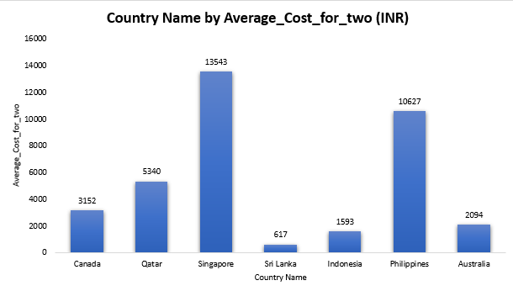
Countries with Rating & Expenditure
Philippines (4.5), Indonesia (4.3), Qatar (4.1) indicating strong food culture and customer satisfaction should maintain quality and leverage positive reviews for tourism marketing
Canada (3.6), Singapore (3.6), and Australia (3.7) have lower ratings, possibly due to higher customer expectations or inconsistent service. should focus on improving consistency in service and food quality to boost customer satisfaction.
Optimize Expansion Budget: Focus on cost-effective locations like Sri Lanka and Indonesia to maximize profit margins while considering premium pricing in Singapore and the Philippines to balance high food expenses.
Menu & Pricing Strategy: Adjust pricing strategies based on location offer premium pricing in Singapore and the Philippines while maintaining affordability in Sri Lanka and Indonesia to attract local customers.

Slide 16
Initial Cities for Expansion
Country Name | City names
Canada | Consort
Canada | Yorkton
Sri Lanka | Colombo
Sri Lanka | Galle*
Singapore | Singapore
Indonesia | Bandung
Indonesia | Bogor
Philippines | Tagaytay City
Philippines | Quezon City
Australia | Dicky Beach
Australia | Inverloch
Qatar | Al Khor*
Qatar | Doha
To prioritize and begin expansion, the following cities have been selected from the countries listed above based on number of restaurants, average cost of two, average rating and average price range. These cities offer potential opportunities for restaurant expansion based on fewer competitors.
For Qatar, Al Khor, and for Sri Lanka, Galle, are potential cities for expansion beyond the currently covered locations.
These cities are among the most prominent in their respective countries and present strong opportunities for network growth and add up new city to the list

Slide 17
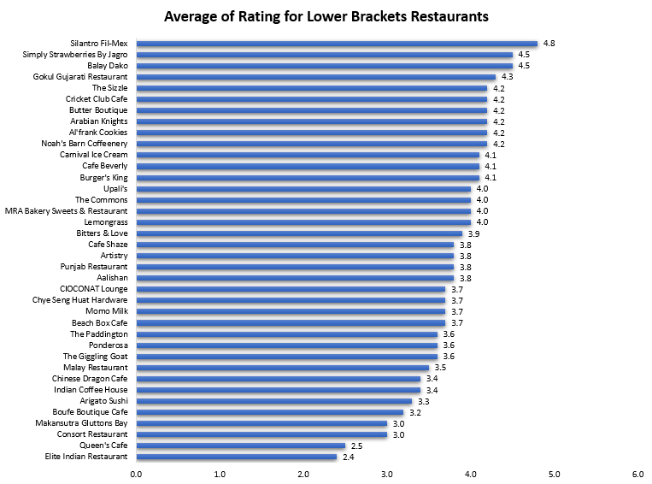
Average Rating for Restaurants
For Lower Bracket
Quality & Service Enhancement for Low-Rated Restaurants: Restaurant should focus on improving menu quality, customer experience, and service training to enhance their ratings.
Brand Differentiation in the 3.5 - 4.2 Range: Restaurants in this range should introduce unique dishes, improve ambiance, or offer promotions to move up in rankings and compete with the top-tier establishments.
For Higher Bracket
Top-Rated Restaurants: Ministry of Crab (4.9), Mainland China Restaurant (4.9), and Gymkhana (4.7) are the highest-rated, showing strong customer satisfaction.
Mid-Tier Ratings (3.0 - 4.0): Many restaurants, like Potato Head Folk (3.1) and The Lokal (3.1), fall in the moderate range, indicating potential areas for improvement.
Consistent Performance: The Manhattan FISH MARKET appears twice with a rating of 4.0, showing steady quality but lacking exceptional differentiation.

Slide 18
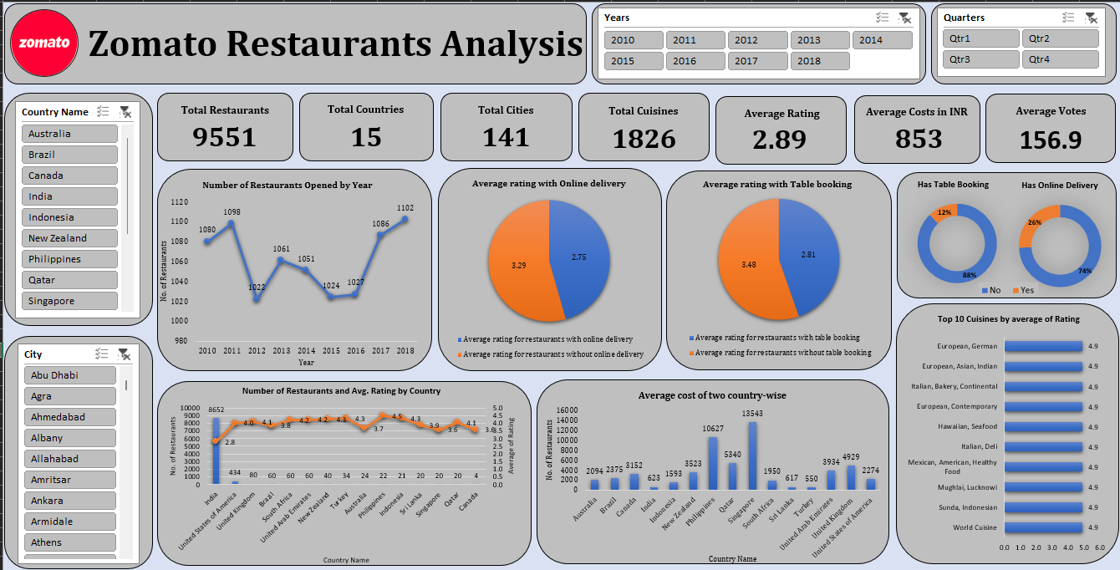
Zomato Restaurants Analysis
The dashboard includes slicers for Country Name, City, Years, and Quarters, enabling users to filter and analyze data dynamically based on specific selections.
Key metrics highlight 9,551 total restaurants across 15 countries and 141 cities, with an average cost of $9.93 and an average rating of 2.89.
The "Number of Restaurants Opened by Year" graph shows fluctuations, with the highest number of openings in 2018 (1,102 restaurants).
Restaurants with online delivery have a lower average rating (2.75) compared to those without (3.29), indicating potential service-related issues.
Restaurants with table booking have an average rating of 2.81, whereas those without table booking score higher at 3.48, suggesting customer preferences for spontaneous dining.
India leads in restaurant count with 8,652 restaurants, followed by the USA (434) and the UK (80), while the price range distribution varies across countries, reflecting different market segments.

Slide 19
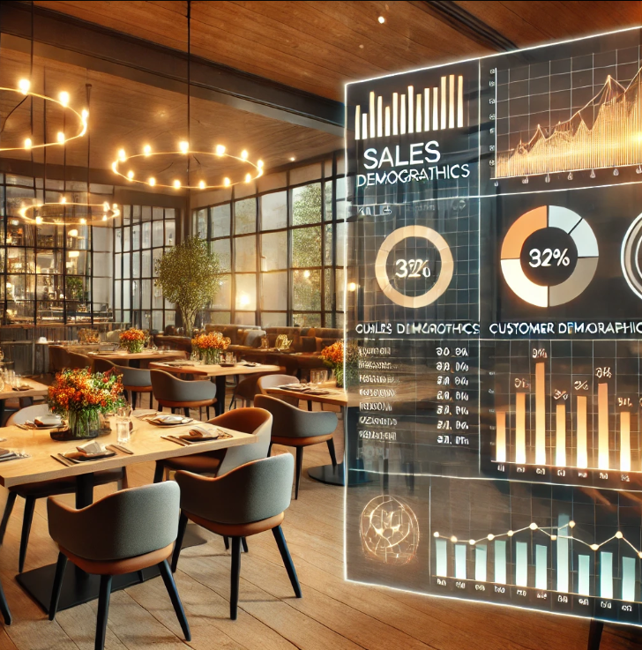
Conclusion
Data Overview: The dataset consists of 2 tables with 22 attributes, including restaurant details, location, pricing, and ratings.
Market Insights: India has the highest number of restaurants (8652), while countries like Australia, Canada, and Qatar have lower competition, making them ideal for expansion.
Customer Behavior: Countries like Indonesia and UAE show higher customer engagement through votes, while Brazil and Singapore have lower engagement.
Restaurant Ratings: Online delivery & table booking services positively impact ratings, with higher-rated restaurants offering these services more frequently.
Cuisines & Preferences: Japanese, Seafood, and Indonesian cuisines consistently receive high ratings (4.4+), making them a strong choice for new restaurant menus.
Expansion Strategy: Focus on cost-effective countries like Sri Lanka & Indonesia, while leveraging high-spending markets like Singapore & the Philippines for premium pricing.
Slicer & Filtering: Slicers were used to dynamically filter data by country, city, cuisine, and rating, enhancing interactive analysis.

Slide 20
Thank you

